Slide 1

CSA5115 – CRYPTOGRAPHY AND NETWORK SECURITY
Ransomware Detection and Prevention System
PRESENTED BY:
D. Gnana Deepthi (192411123)
Akshitha T.R (192521349)
V. Maduri Priya(192311368)
GUIDED BY:
Sangeetha T

Slide 2


ABSTRACT
Ransomware is a major cybersecurity threat that can encrypt and damage user files. The Ransomware Detection and Prevention System detects suspicious activities using file activity monitoring, malware signature detection, and encryption behavior analysis. When ransomware-like behavior is identified, the system helps prevent further malicious activity and generates alerts. The system provides an additional layer of protection against both known and suspicious ransomware activities. This provides a practical approach to protect files and reduce the impact of ransomware attacks.

Slide 3
INTRODUCTION
Ransomware is a type of malware that restricts access to user data.
It can rapidly modify and encrypt files on a system.
Traditional security methods may not detect new ransomware variants effectively.
Monitoring file activity and analyzing malicious behavior can help identify threats early.
The proposed system combines multiple detection techniques for ransomware prevention

Slide 4
PROBLEM STATEMENT
Ransomware can rapidly affect a large number of files.
Unknown ransomware variants may bypass traditional signature-based detection.
Abnormal file activity and encryption behavior need continuous monitoring.
Known ransomware threats require effective signature-based identification.
Delayed detection can increase data loss and system impact.
A real-time system is required to detect suspicious behavior and prevent further damage

Slide 5
OBJECTIVE
To monitor file activities for suspicious behavior.
To detect known ransomware using malware signatures.
To analyze abnormal encryption behavior.
To identify ransomware activity at an early stage.
To prevent malicious file operations and generate security alerts.

Slide 6
LITERATURE REVIEW
Author / Study | Year | Key Finding | Limitations
Alshaikh et al. – Cryptographic Ransomware Encryption Detection: Surve | 2023 | Identified file-system activity, I/O monitoring, and system/API calls as important techniques for detecting ransomware encryption behavior. | Detection approaches may have difficulty adapting to new ransomware behaviors
Chew et al. – Real-Time System Call-Based Ransomware Detection | 2024 | Proposed real-time ransomware detection by analyzing behavioral patterns from system calls | System-call monitoring can introduce processing overhead and may depend on platform-specific behavior.
Lightweight and Robust Ransomware Detection Using Behavioral Analysis | 2025 | Used behavioral features such as file changes and encryption patterns to improve ransomware detection efficiency. | Behavior-based detection may require continuous monitoring and can increase system resource usage.

Slide 7
PROPOSED SYSTEM
A multi-layered system is proposed to detect and prevent ransomware attacks.
File Activity Monitoring continuously tracks suspicious file operations and abnormal changes.
Malware Signature Detection identifies known ransomware using predefined malware signatures.
Encryption Behavior Analysis identifies rapid and abnormal encryption patterns across multiple files.
Detected ransomware activity triggers Threat Prevention to restrict further malicious file operations.
Real-time alerts notify the user when suspicious or malicious activity is identified.
The combined approach helps provide early detection and protection against ransomware attacks

Slide 8
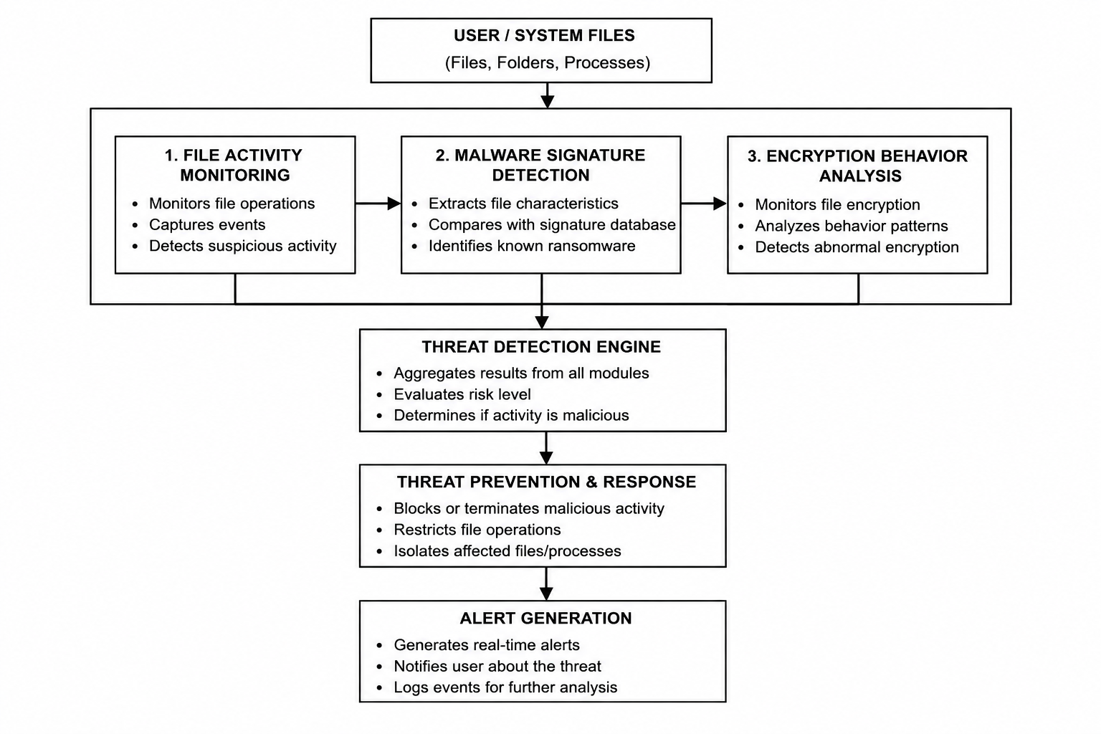
SYSTEM ARCHITECTURE
FIG 1.1 SYSTEM ARCHTECTURE OF MALWARE DETECTION AND PREVENTION SYSTEM

Slide 9
MODULE 1: FILE ACTIVITY MONITORING
This module continuously monitors file operations performed within the system.
File creation, modification, deletion, and renaming activities are tracked.
The frequency and pattern of file operations are analyzed.
Rapid or abnormal changes across multiple files are identified as suspicious.
Suspicious file activity is forwarded to the detection stage for further analysis.
Early identification of unusual activity helps reduce the impact of ransomware

Slide 10
MODULE 2 – MALWARE SIGNATURE DETECTION
This module detects known ransomware using predefined malware signatures.
Suspicious files or processes are analyzed for identifiable malicious characteristics.
Extracted characteristics are compared with the available signature database.
A matching signature indicates a known malware threat.
Detected threats are classified and forwarded to the prevention mechanism.
Signature-based detection provides fast identification of previously known ransomware.

Slide 11
MODULE 3 – ENCRYPTION BEHAVIOUR ANALYSIS
This module analyzes abnormal encryption behavior associated with ransomware.
The system monitors rapid encryption and large-scale file modifications.
Multiple file encryption activities within a short period are treated as suspicious.
Detected ransomware-like behavior is evaluated by the threat detection mechanism.
Malicious activity is restricted to prevent further file modification.

Slide 12
SOFTWARE IMPLEMENTATION
Core Detection — SHA-256 & Signature Matching :
def calculate_hash(file_path):
sha256 = hashlib.sha256()
with open(file_path, "rb") as file:
while data := file.read(4096):
sha256.update(data)
return sha256.hexdigest()
def check_signature(file_path):
file_hash = calculate_hash(file_path)
cursor.execute(
"SELECT threat_name FROM signatures WHERE file_hash = ?",
(file_hash,)
)
return cursor.fetchone()

Slide 13
SOFTWARE IMPLEMENTATION
Behavior Analysis & Threat Prevention :
def analyze_behavior(recent_events):
score = 0
if len(recent_events) >= 10: score += 30
if monitor.modified >= 10: score += 20
if monitor.created >= 5: score += 10
if monitor.renamed >= 5: score += 10
return min(score, 100)
if score >= 70:
threat_label.config(text="Threat Level: CRITICAL")
trigger_prevention("Ransomware-like activity", score)

Slide 14
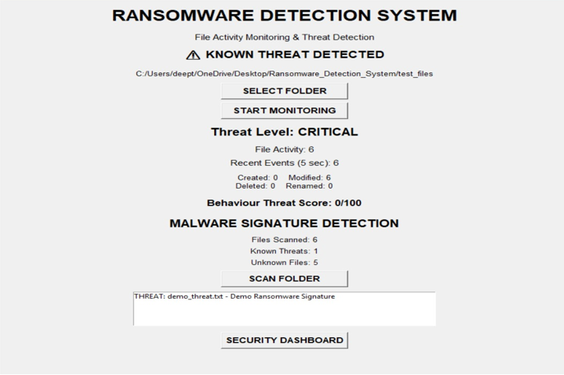
FIG 1.2 RANSOMWARE DETECTION AND PREVENTION SYSTEM

Slide 15
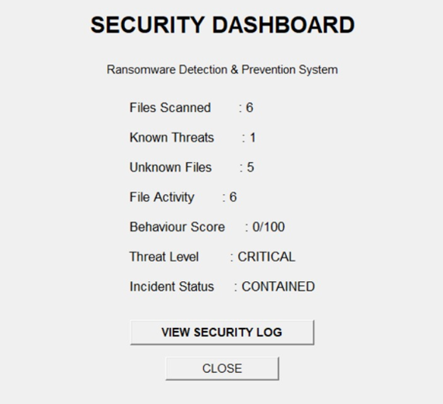
FIG 1.3 SECURITY DASHBOARD

Slide 16
RESULTS
The system successfully monitors file activities and identifies suspicious file operations.
Known ransomware threats are detected using malware signature analysis.
Abnormal encryption behavior across multiple files is identified as a potential ransomware attack.
Detected threats trigger prevention measures to restrict further malicious file activity.
Real-time alerts provide immediate notification when suspicious activity is detected.
The combined approach provides an effective layer of protection against ransomware attacks.

Slide 17
IEEE STANDARDS
➢ IEEE 830 – Software Requirements Specification
➢ IEEE 1016 – Software Design Description
➢ IEEE 1471 – System Architecture
➢ IEEE 610 – Software Engineering Terminology
➢ IEEE 829 – Software Testing Documentation
➢ IEEE 29148 – Requirements Engineering
➢ IEEE 12207 – Software Life Cycle Processes

Slide 18
APPLICATIONS
Protects computers from malware and ransomware attacks.
Monitors suspicious file activities in real time.
Helps prevent unauthorized file encryption and data loss.
Provides real-time alerts about detected threats.
Isolates affected files or processes to prevent further damage.
Helps organizations maintain system and data security.
Supports system administrators in identifying and responding to threats quickly.

Slide 19
CONCLUSION
The system provides a multi-layered approach to ransomware detection and prevention.
File activity monitoring helps identify suspicious operations.
Malware signature detection identifies known ransomware threats.
Encryption behavior analysis helps detect ransomware-like activity.
Threat prevention reduces the possibility of further file damage.
The system provides an effective and practical approach for improving data security against ransomware attacks

Slide 20
FUTURE SCOPE
Machine learning can be integrated to detect unknown ransomware variants.
Advanced behavioral analysis can improve detection accuracy.
Cloud-based threat intelligence can provide updated malware signatures.
Automated file backup and recovery mechanisms can be added.
The system can be extended for enterprise-level ransomware protection.
Real-time monitoring and reporting can be enhanced for faster threat response.

Slide 21
REFERENCES
CISA. (2025). StopRansomware Guide: Ransomware Prevention and Response. Cybersecurity and Infrastructure Security Agency.
MITRE ATT&CK. (2025). Data Encrypted for Impact (T1486). MITRE Corporation.
Microsoft Security. (2025). Ransomware Protection and Prevention. Microsoft.
IBM Security. (2024). What is Ransomware? Ransomware Detection, Prevention and Protection.
Alhawi, M., Baldwin, J., & Dehghantanha, A. (2018). Leveraging Machine Learning Techniques for Windows Ransomware Network Traffic Detection. Cyber Threat Intelligence.

Slide 22


